Slide 1

Pulse of the Planet
Understanding Climate Change
Deke Arndt
Chief, Climate Monitoring
NOAA’s National Centers for Environmental Information
Asheville, North Carolina
November 2017
National Oceanic and Atmospheric Administration | NOAA Satellite and Information Service

Slide 2
Today
Hello from NCEI
How do we know climate is changing?
How do we know humans are driving today’s changes?
What are some of the impacts?
  On weather
  On humans and human systems
  On living systems
Story
Related Resources from NOAA and our partners –
Where does all this come from and how can folks get to it?

Slide 3
Introductions

Slide 4
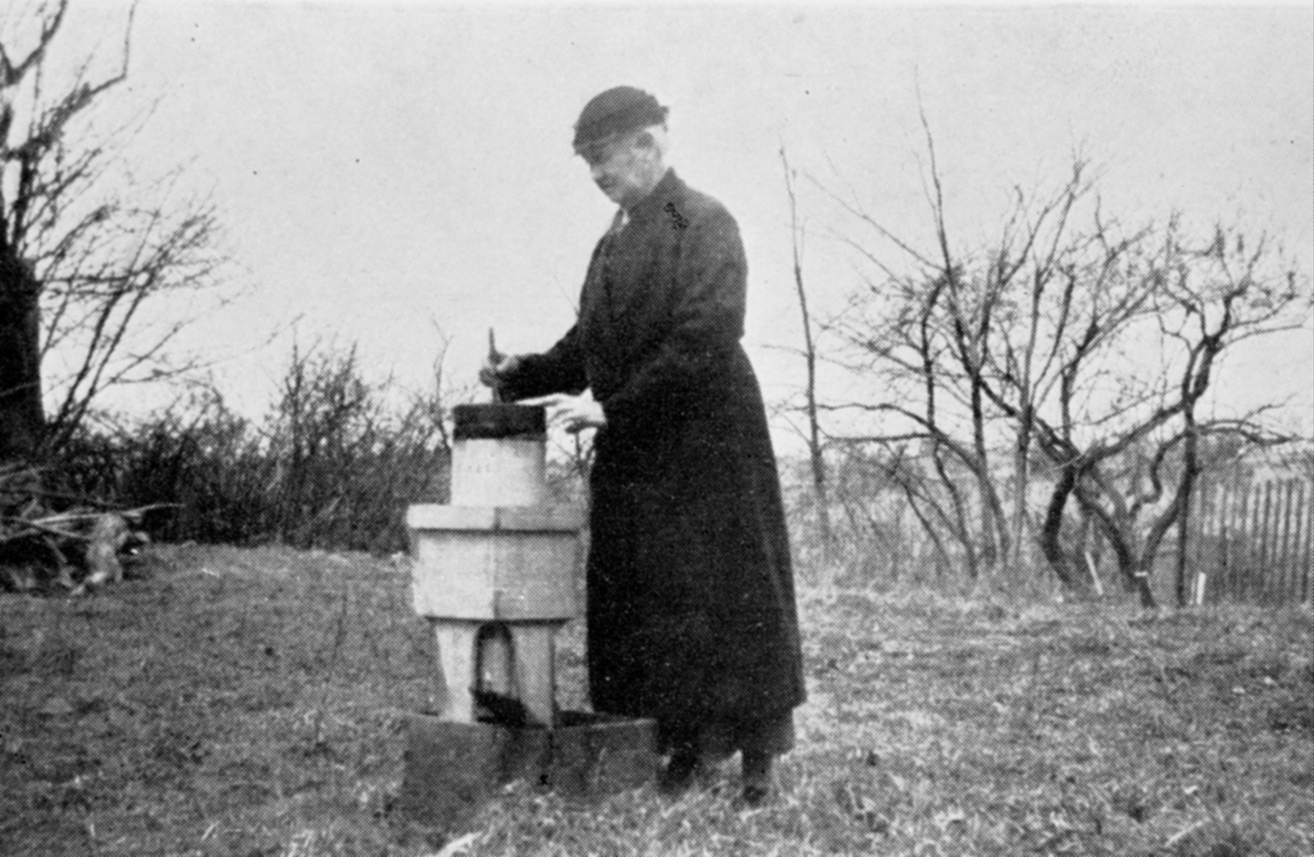

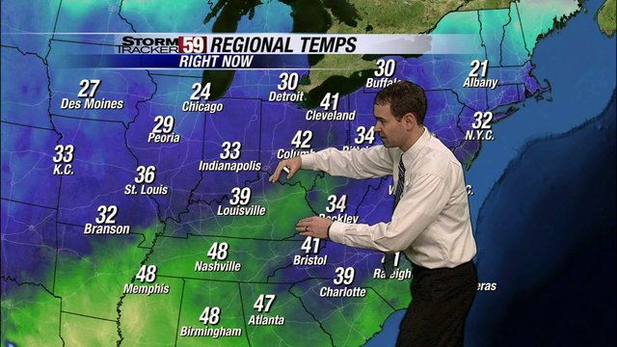
National Centers for Environmental Information – Asheville, NC

Slide 5
















NCEI Monitoring Branch & US Drought Portal http://www.ncdc.noaa.gov/climate-monitoring and http://www.drought.gov
(Andrew)
(Nancie)

Slide 6
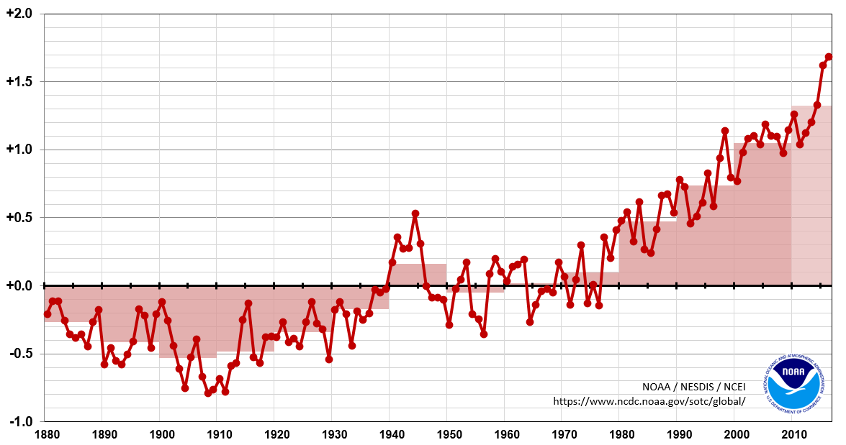
If you know us, it’s probably for this
Difference From 20th Century Average, in °F
Year | Probability of Warmest Rank
2016 | 62%
2015 | 36%
others | 2%
2016:
+0.94°C / +1.69°F
above 1901-2000 average;
warmest year of record

Slide 7

However …

Slide 8
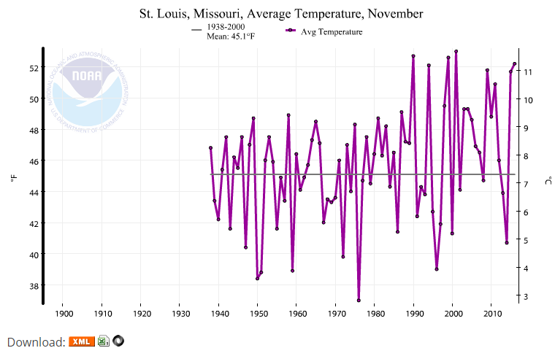
Other, more directly practicable, metrics
“Climate at a Glance”
https://www.ncdc.noaa.gov/cag

Slide 9
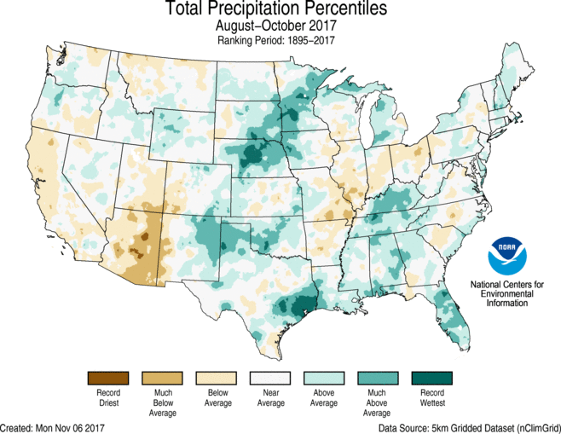
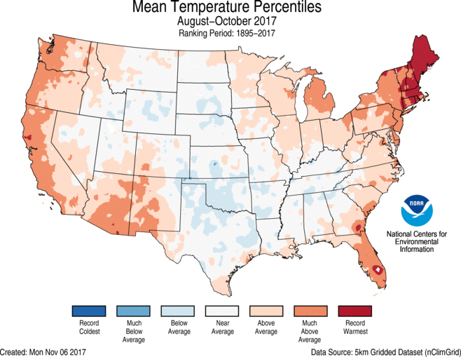
Other, more directly practicable, metrics
Monthly state of the climate reports
(U.S.)
https://www.ncdc.noaa.gov/sotc

Slide 10
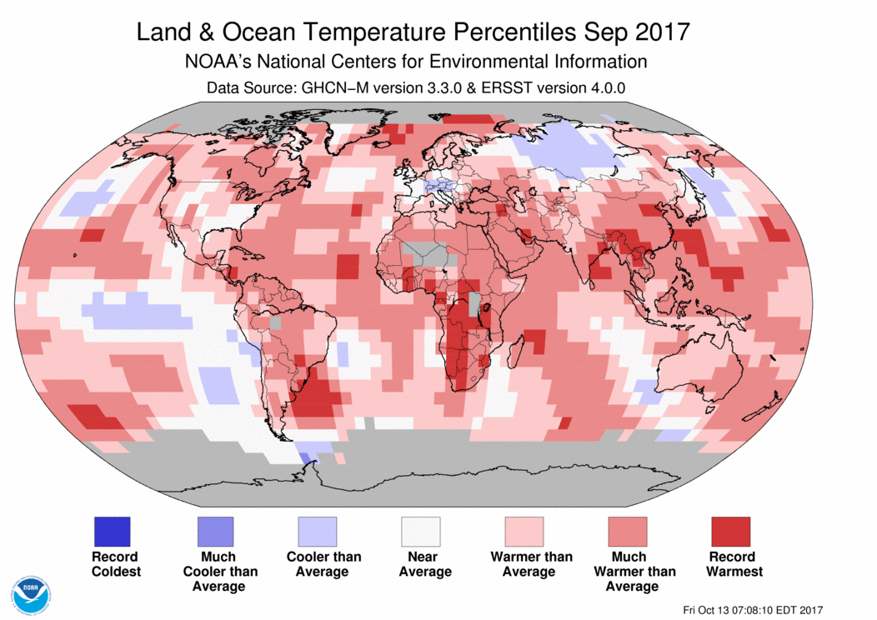
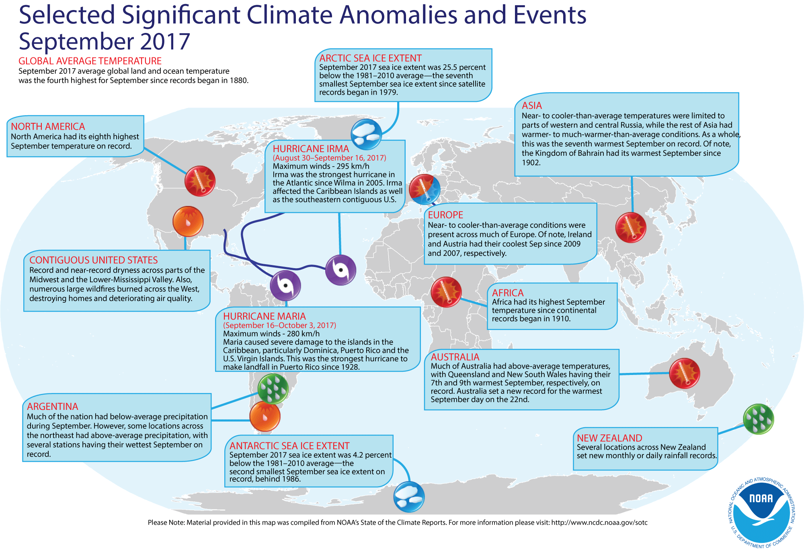
Other, more directly practicable, metrics
Monthly state of the climate reports
(global)
https://www.ncdc.noaa.gov/sotc

Slide 11
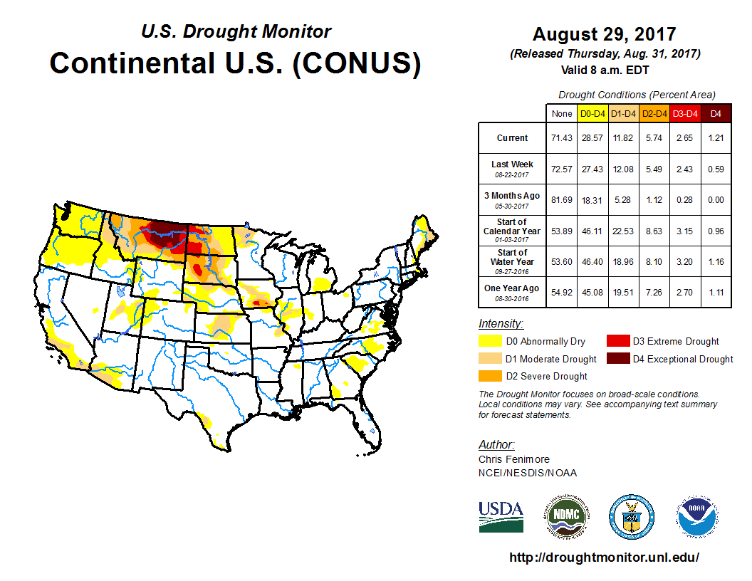
Other, more directly practicable, metrics
U.S. Drought Monitor
https://www.drought.gov

Slide 12
How do we know climate is changing?
Indicators of climate change

Slide 13
Global Surface Temperature
Difference From 20th Century Average, in °F
Year | Probability of Warmest Rank
2016 | 62%
2015 | 36%
others | 2%
2016:
+0.94°C / +1.69°F
above 1901-2000 average;
warmest year of record

Slide 14
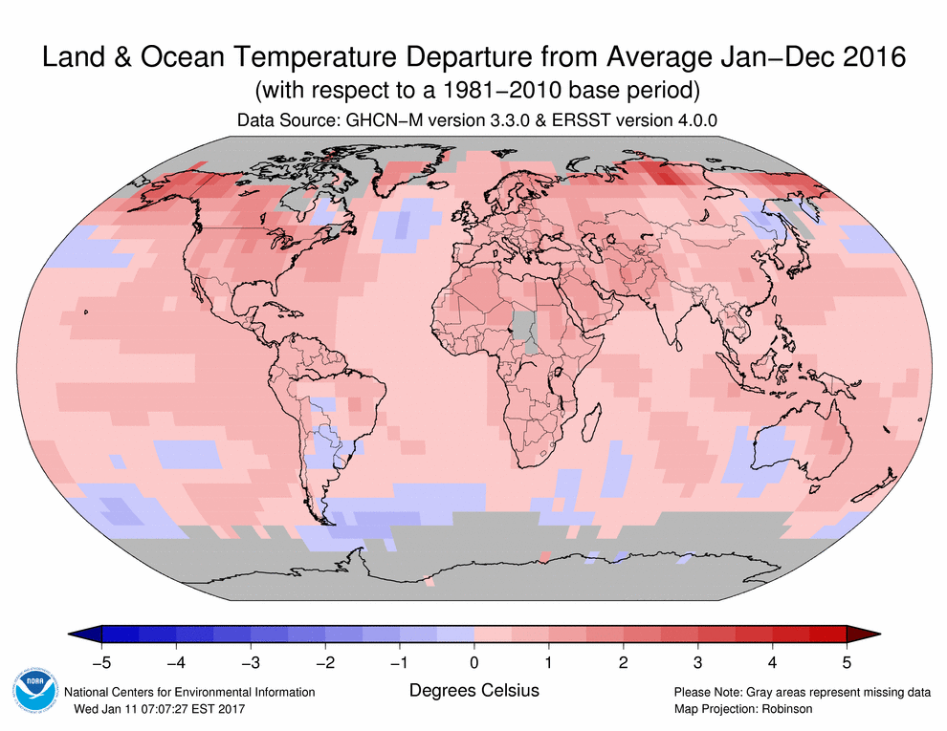
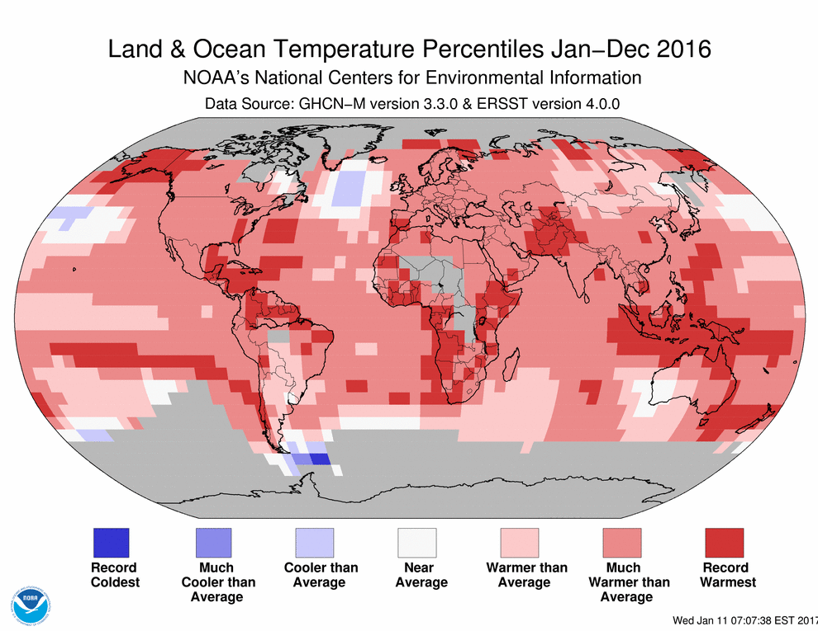
How “warmest on record” looks on a map
http://www.ncdc.noaa.gov/sotc/global

Slide 15
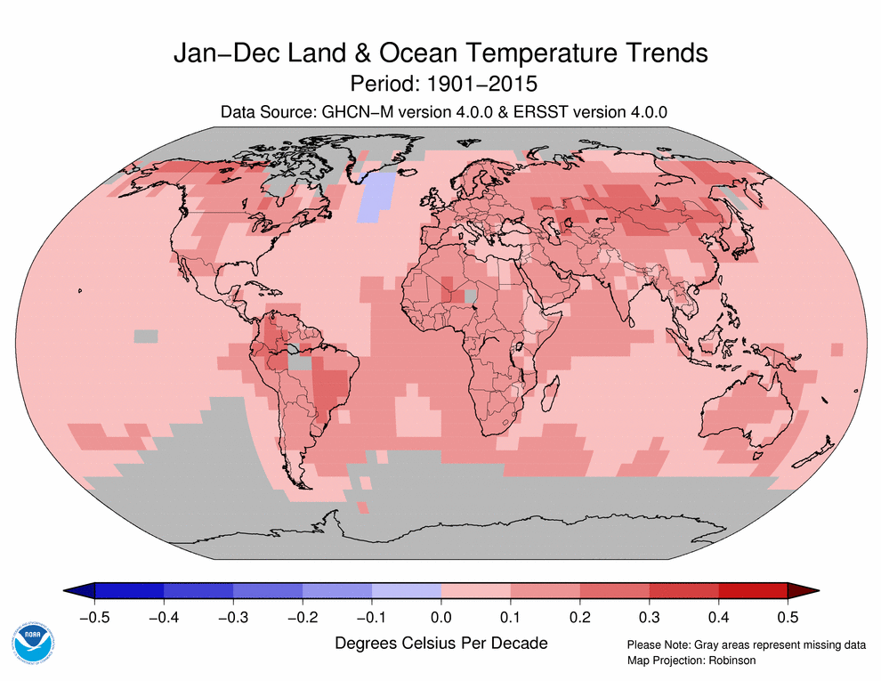
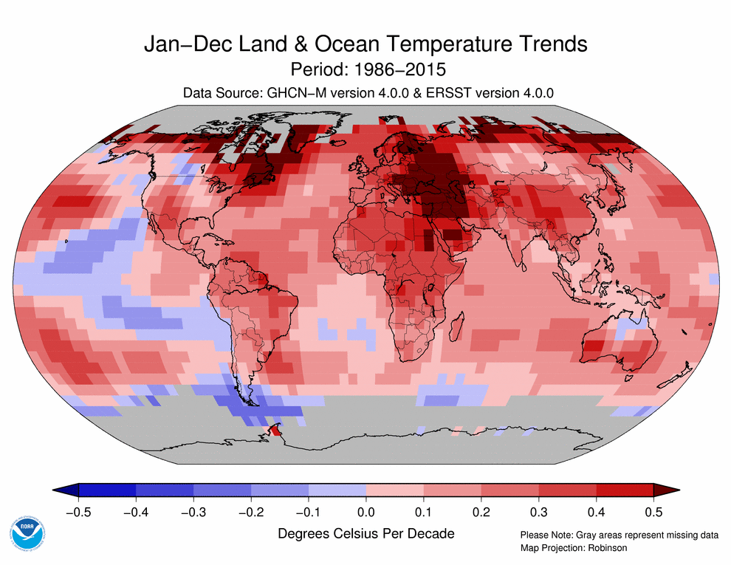
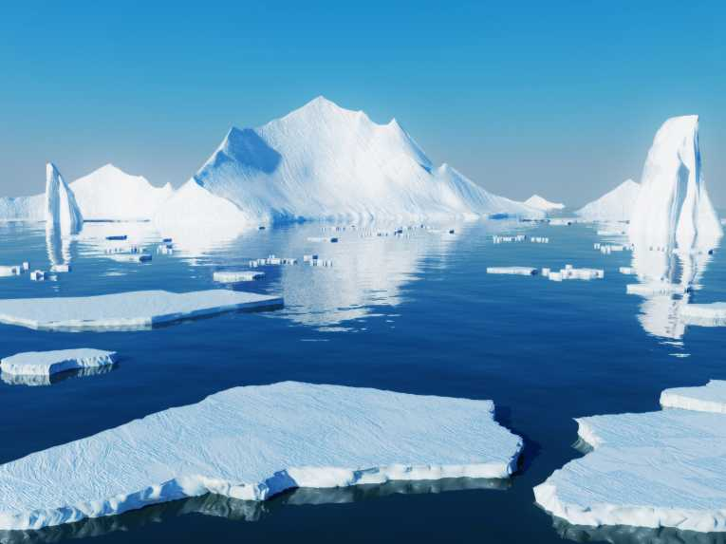
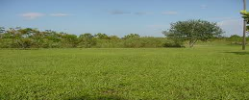

The Rate of Warming varies around the world
In the past half century, temperatures in these major zones increased by:
Arctic: 0.72°F / decade
Land surface: 0.43°F / decade
Sea surface: 0.22°F / decade
Dataset: NOAA GlobalTemp

Slide 16
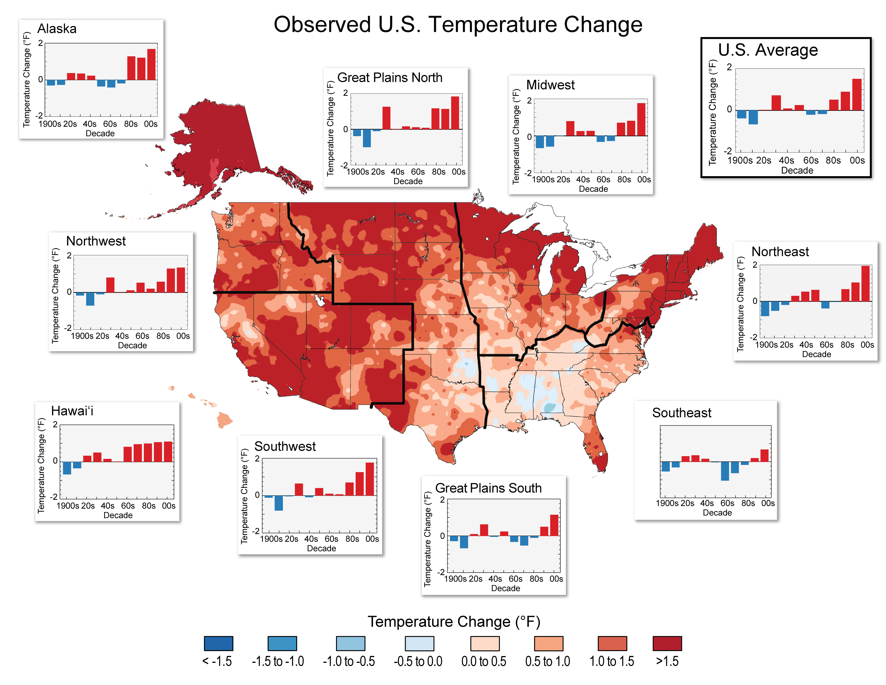
… and around the country
National Climate Assessment:
http://nca2014.globalchange.gov/report

Slide 17
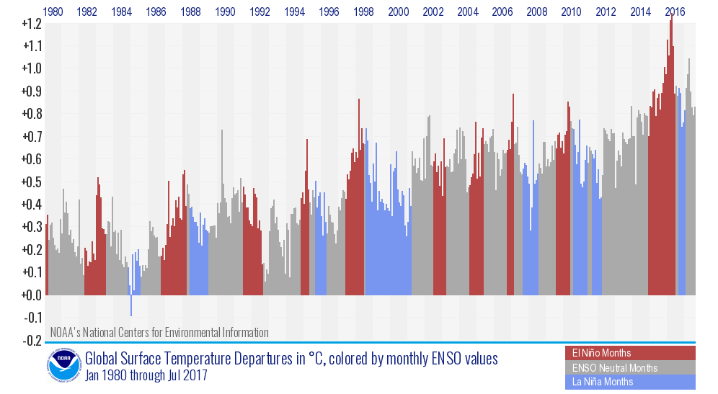
Variability still plays a role!
Months with La Niña sea-surface temperature conditions in blue
Months with El Niño sea-surface temperature conditions in red
http://www.ncdc.noaa.gov/sotc/global/

Slide 18
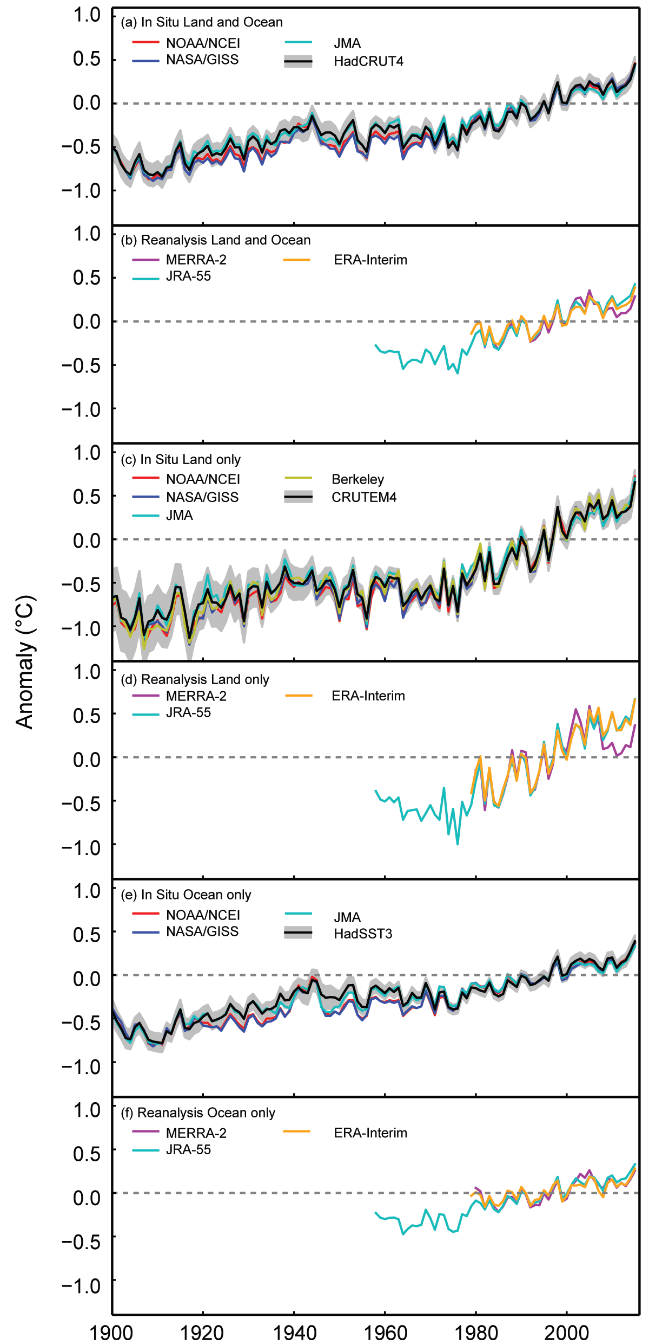
Multiple datasets
Anomalies from 1981–2010
(°C)

Slide 19
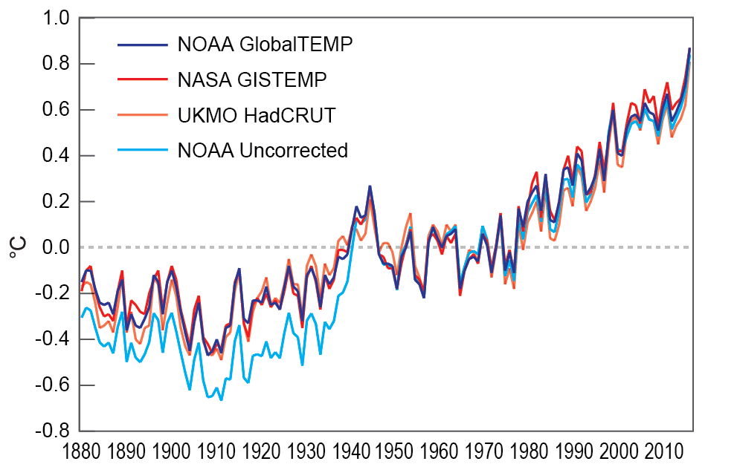
The rest of the story: adjustments reduce the warming rate
relative to a common 1951-80 base period

Slide 20
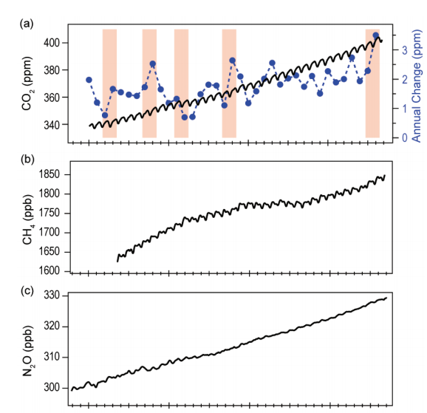
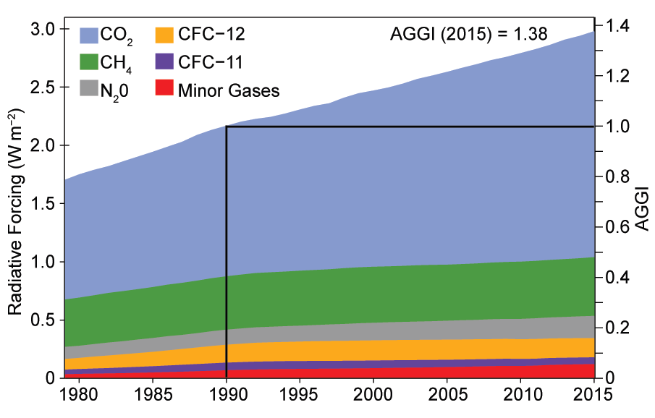
Greenhouse Gases Reach New Record Highs
2016: 402.9 ppm
2016: 1843.0 ppb
Radiative forcing from GHGs now 2.98 W/m2 above preindustrial times, up 38% since 1990 and 2% increase over 2014.
CO₂ contributes to about 2/3 of this forcing.
2016: 328.9 ppb
Notes:
Global CO₂ has been above 400 ppm 3 months of 2015 (Mar-May)

Slide 21
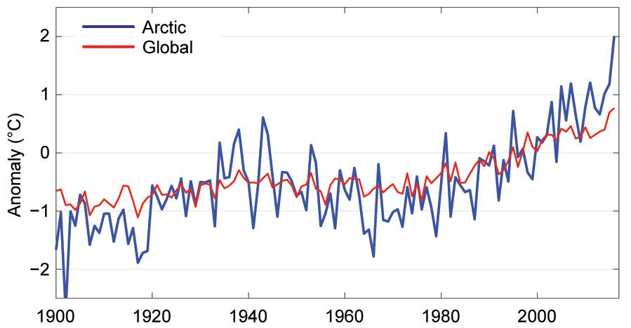
Arctic Temperature “Amplification”
SoC 2016 Fig. 5.1

Slide 22
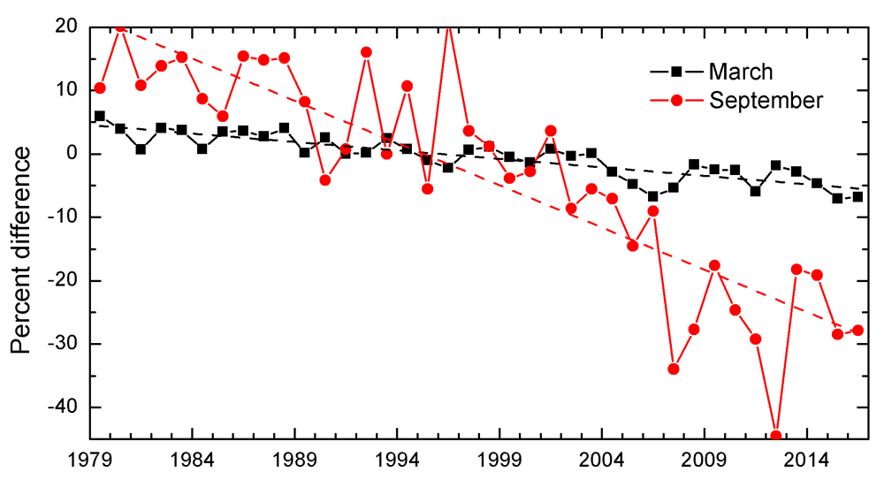
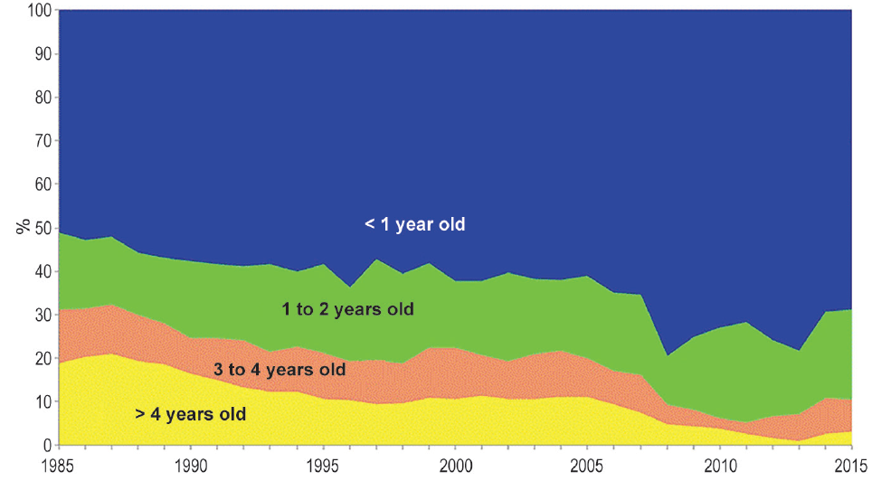
Arctic Sea Ice
Composition of March Arctic sea ice, by ice age
State of the Climate in 2015: Fig. 5.6a
March and September Arctic sea ice extent
Adapted from State of the Climate in 2016: Fig. 5.5
Notes:
2014 was 1.1ºC / 2.0ºF warmer than 1981–2010 average.
4th warmest year since records began in the early 20th century.
Rapid declines in sea ice and snow extent are compelling evidence of the rapid response of both the terrestrial and marine cryosphere to Arctic amplification.
February-March 2015:
4+ year ice made up 3% of pack (vs 20% in 1985)
First year ice made up 70% of pack (vs. 35% in 1985)

Slide 23
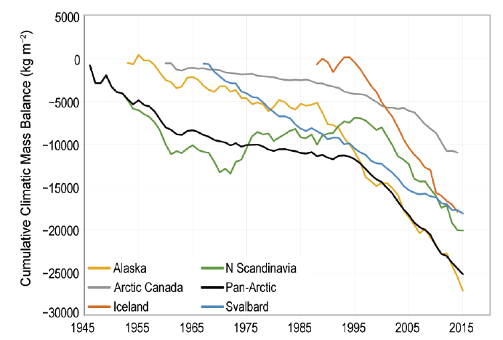
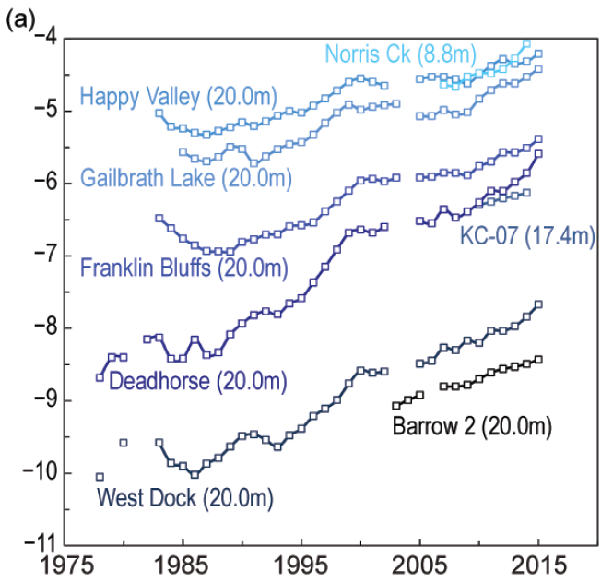
Glaciers and Permafrost Changes
Cumulative glacier mass for several Arctic regions
Permafrost temperature at several N. American locations
State of the Climate in 2016; Fig. 5.13
Temperature, degrees Celsius
2015 was the 32nd consecutive year of glacier ice loss
Since 1980, the average glacier has lost ice equal to a 18-meter / 60-foot slab off the top
Notes:
Based on 37 reference glaciers from 13 countries around the world
Reference glacier: have continuous long-term observation series.
Lemon Creek Glacier is near Juneau, southern Alaska
Globally: preliminary data indicates 2015 was the 36th consecutive year of glacier ice loss.
Permafrost changes: warming at continuously frozen locations (as above), more thawing at locations with annual freeze / thaw cycle, and novel thawing at some locations

Slide 24
Shepard Glacier, Glacier National Park
United States of America, 1911-2005
Source: USGS Photo Library

Slide 25
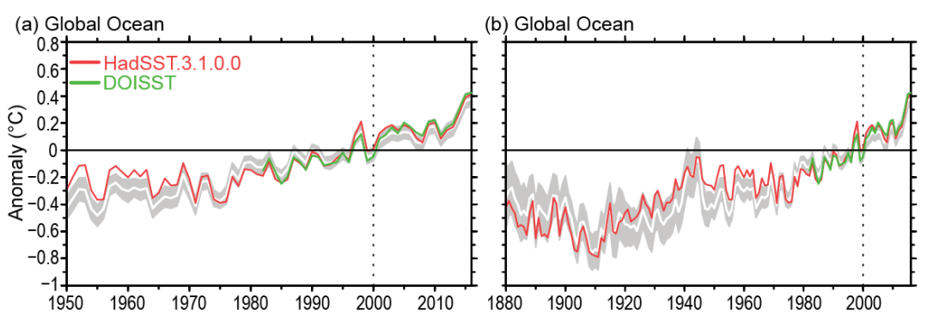
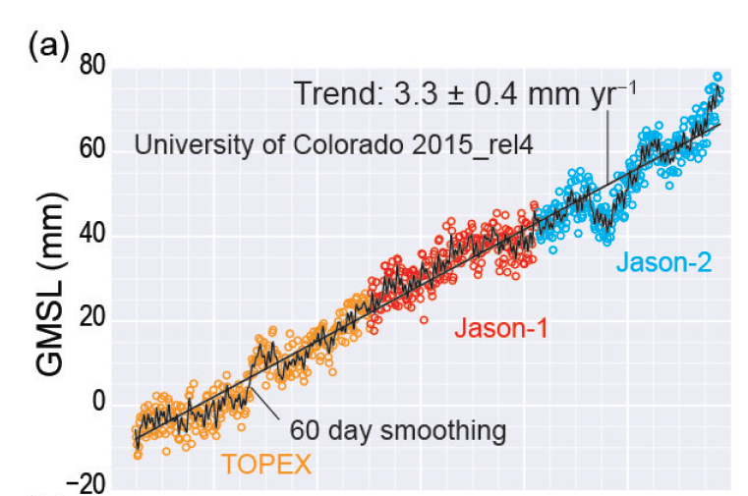
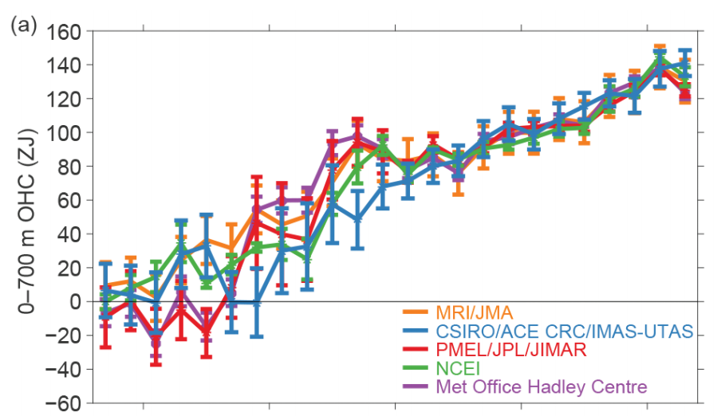
2016: Record High Sea Level & SST
Global SST Anomaly
Global Mean Sea Level
Global 0-700 m Ocean Heat Content
1992
1996
2000
2004
2008
2012
2016

Slide 26
How do we know it’s driven by people?

Slide 27
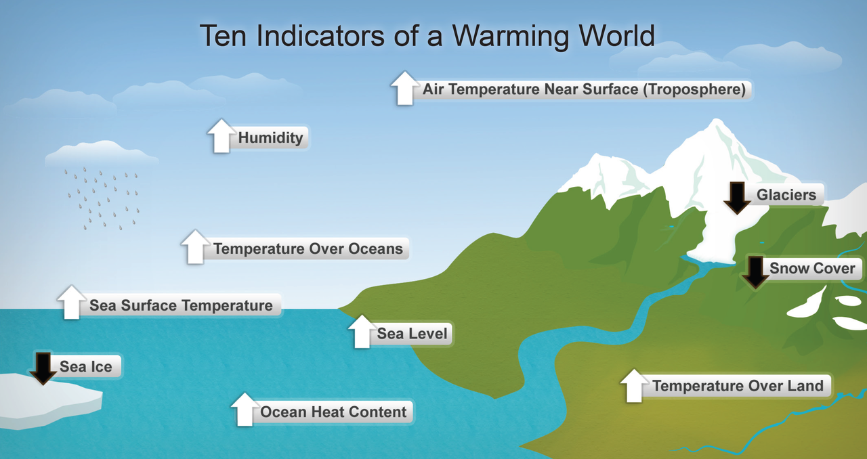
Multiple indicators

Slide 28
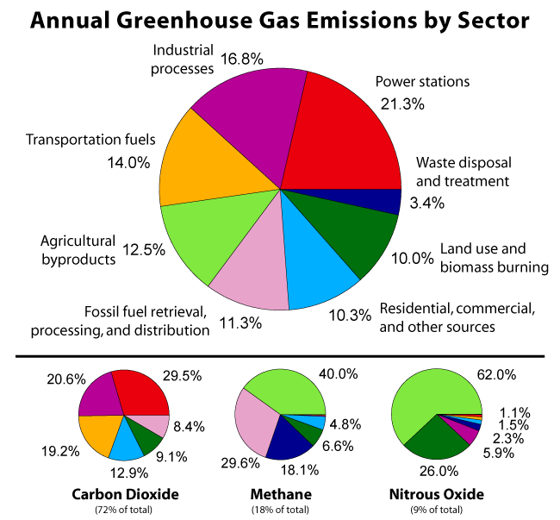
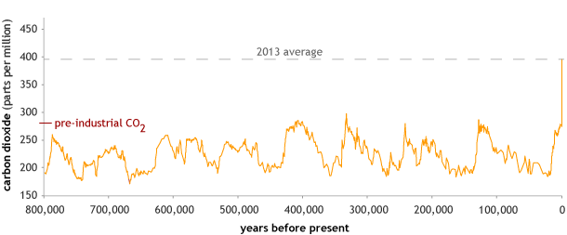
GHG Concentrations and Sources
Greenhouse Gas Sources from Human Activities

Slide 29
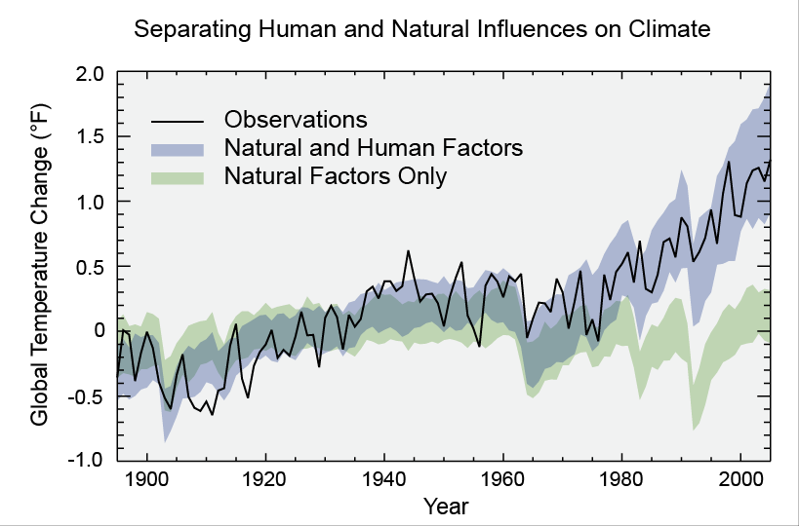
Increased T_{sfc} expected w/ increased GHG
3rd National Climate Assessment, 2014.

Slide 30
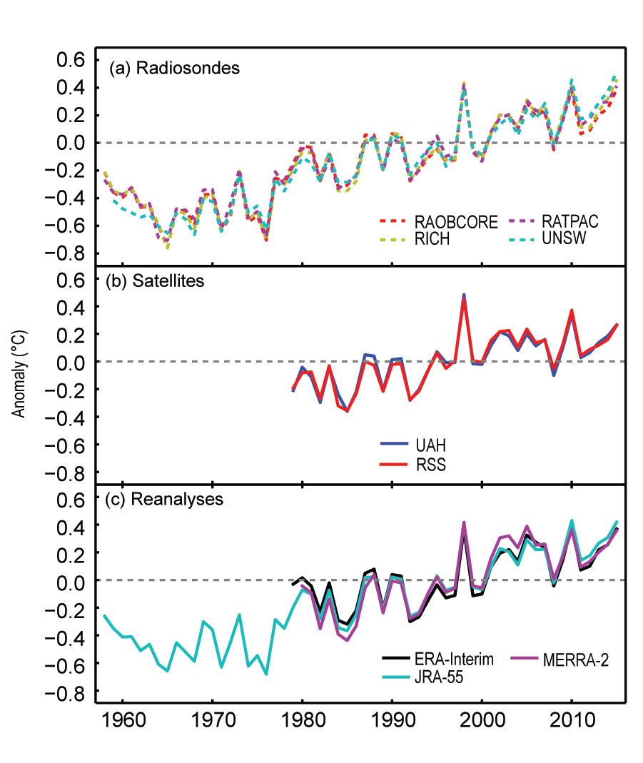
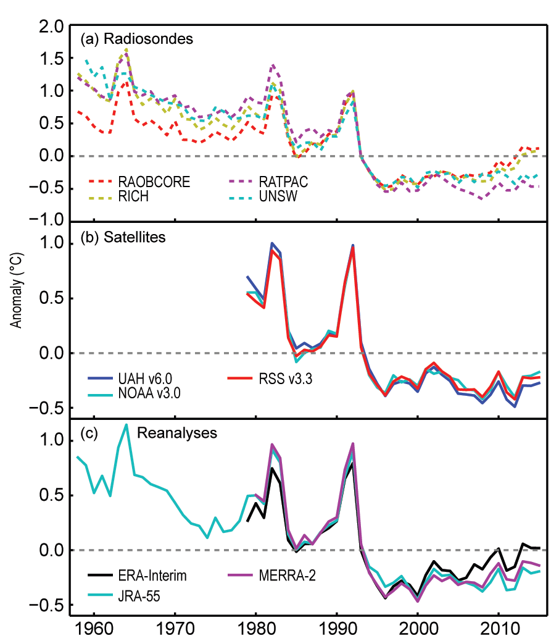
Upper Atmosphere Temperatures:
Long-Term Trends
Lower Troposphere:
Up to ~6 miles above Earth’s surface
Lower Stratosphere:
~7-16 miles above Earth’s surface

Slide 31
Thanks for all the charts – how, when and where does it matter?

Slide 32
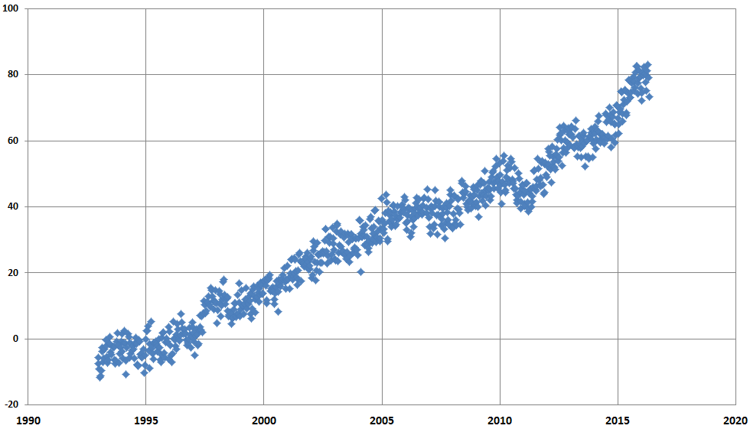
Globally … sea level rise
Since 1993, about 3.3 inches mean sea level rise

Slide 33
However …

Slide 34
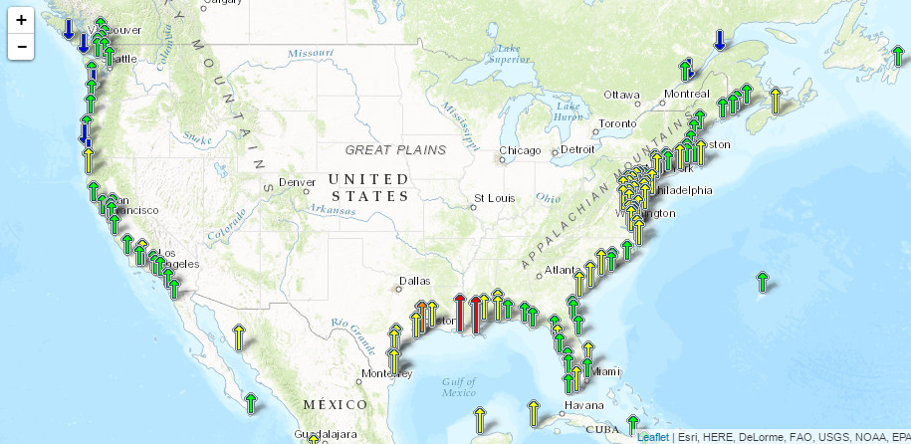
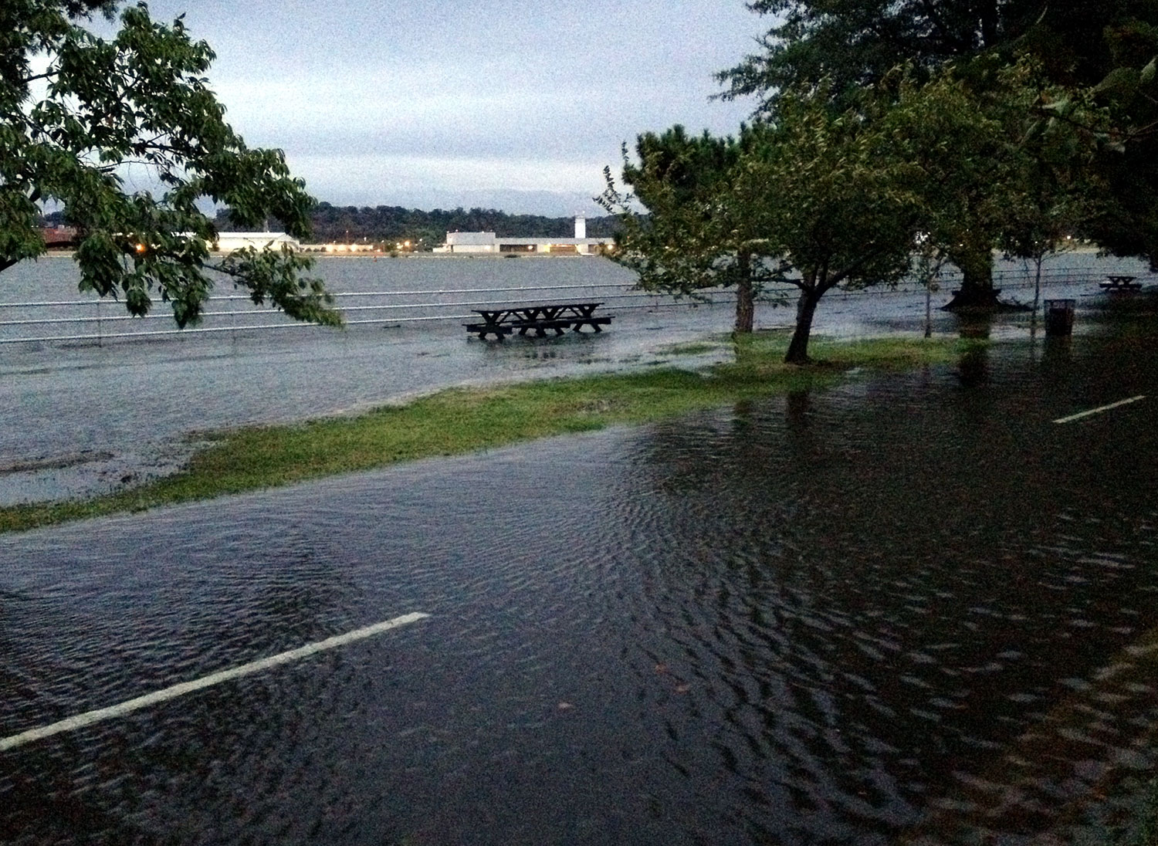
At the coasts … recurrent tidal flooding http://oceanservice.noaa.gov/facts/nuisance-flooding.html

Slide 35
Shepard Glacier, Glacier National Park
United States of America, 1911-2005
Roughly one billion around the world people depend on seasonal glacial melt for a significant portion of their domestic or agricultural water supply
Source: USGS Photo Library

Slide 36
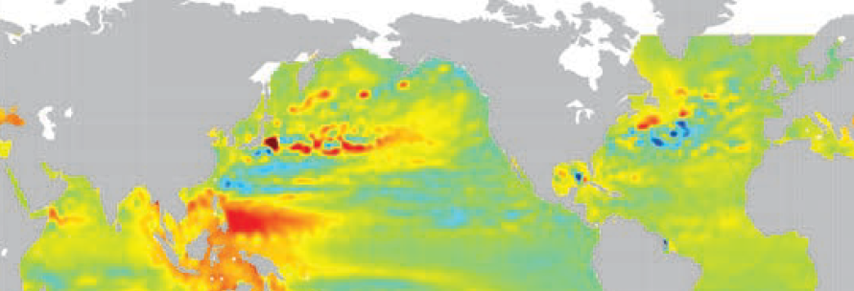
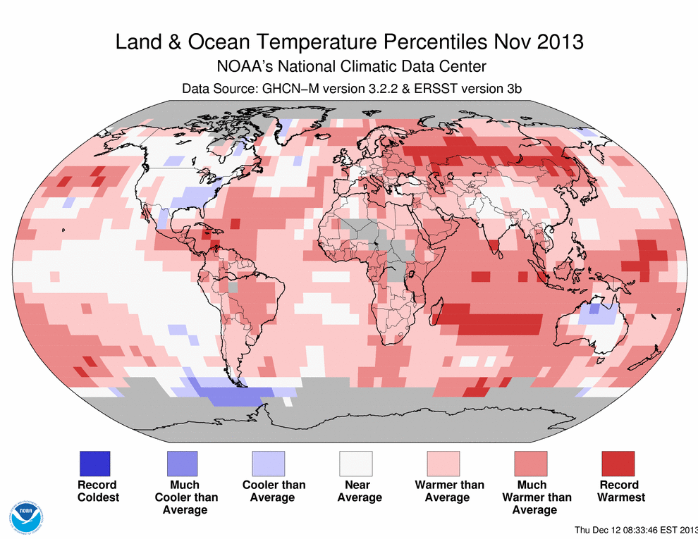
Haiyan, 2013
2013 MSL anomalies
Fig 3.28 from State of the Climate in 2013
SSH section: Merrifield et al. (2014)
(“unusual behavior”) Lander, Guard & Camargo (2014):
Strongest wind speeds assigned to tropical cyclone
High intensity at such low latitude (~5°N)
Record-setting intensity at landfall
“Extreme” intensity overall in the basin

Slide 37


Locally

Slide 38
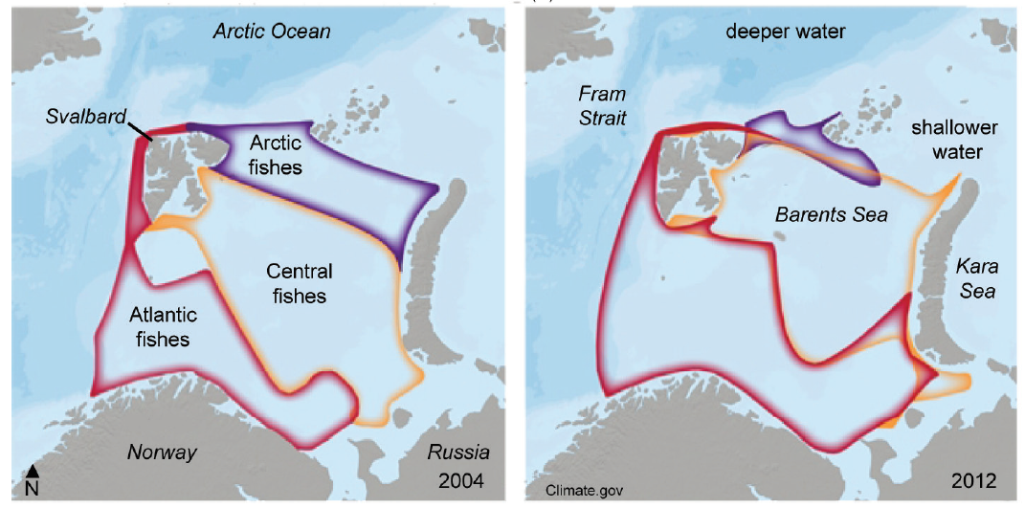
Rapid Change Affects Living Systems
Plants and animal life on the move
More southern species and more “generalist” species adapting; more northern and more specialized species under stress
Fisheries in the Barents Sea: 2004 vs. 2012

Slide 39
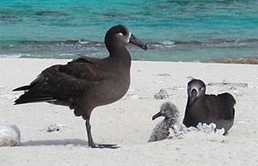


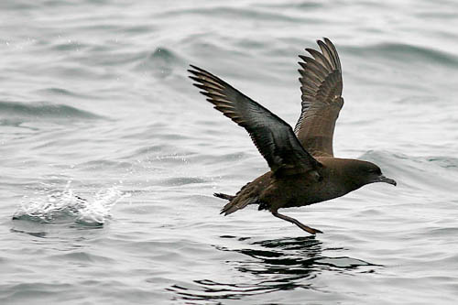

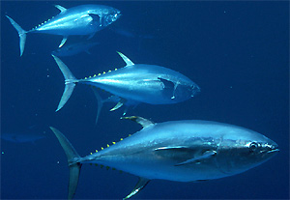
Habitats in the Oceans are Projected to Shift
Winners
Losers
Sooty Shearwater
Blue Shark
Tuna
Blackfoot Albatross
Blue Whale
Loggerhead Turtle
Source: NOAA study published in Nature climate change, Sept 2012
Notes:
Species that have a narrower comfort range are more at risk of habitat loss than those with broader ranges.
Sharks are at the greatest risk of habitat loss with climate change, according to a NOAA analysis of 15 top predators published yesterday in the journal Nature Climate Change. Blue whales and loggerhead sea turtles are also looking at reductions in core habitat of as much as 16 percent and 24 percent, respectively.
In contrast, seabirds like the sooty shearwater and blackfoot albatross, as well as tunas, are projected to expand their habitats.
Similar to terrestrial projections, water temperatures are expected to get warmer at higher latitudes. The North Pacific Transition Zone, a pathway where many animals migrate across the ocean, is projected to move 620 miles north.

Slide 40
The complex model of what you’ll need to know while “doing something” about climate change
The Water Cycle
Vulnerability
Other things
that make us specialists

Slide 41
Climate and Extreme Weather

Slide 42
State records since 2010
Individual Months:
Mar 2010: NJ RI
Apr 2010: CT IL MA ME MI NH NJ* RI
May 2010: FL AK
Jun 2010: DE LA* NC NJ IA MI
Jul 2010: CT* DE* MA* RI*
Aug 2010: LA*
Sep 2010: MN
Oct 2010: FL
Dec 2010: FL UT
Mar 2011: TX
Apr 2011: IL IN KY MI* NY OH PA TN WV
Jun 2011: LA TX NM
Jul 2011: DE* MD* OK TX
Aug 2011: AZ CO FL LA NM OK TX NH NJ NY VT
Sep 2011: OR PA
Nov 2011: RI
Jan 2012: AK
Mar 2012: CONUS AL AR CT GA IA IL IN KS KY MA MI MN MO MS NC ND NE NH NJ NY OH OK PA RI SC SD TN VA VT WI WV
Jun 2012: CO FL UT* WY
Jul 2012: DE MD VA
Aug 2012: NV MS
Sep 2012: CA MN MT ND SD
Oct 2012: DE
Nov 2012: NH WV
Feb 2013: GA
Apr 2013: ND IA MI
May 2013: IA
Jun 2013: NJ UT
Jul 2013: CT MA RI FL
Sep 2013: CO OR WA
Oct 2013: AK
Jan 2014: CA
Jun 2014: AK MN
Jul 2014: AR
Aug 2014: MT
Feb 2015: AZ CA OR WA
Apr 2015: FL
May 2015: AK CT MA NH CONUS CO OK TX UT
Jun 2015: CA ID OR UT* WA IL IN OH
Jul 2015: KY
Sep 2015: CO CT MA ME MI MN RI UT WI
Oct 2015: WA SC
Nov 2015: NJ AR MO
Dec 2015: CONUS AL AR CT DE FL GA IA IL IN KS KY MA MD ME MI MN MO MS NH NJ NY NC OU OK PA RI SC TN VA VT WI WV CONUS IA NC OK WI
Feb 2016: AK
Mar 2016: LA
Apr 2016: AK
Jun 2016: AZ UT
Jul 2016: FL NM
Aug 2016: CT DE MA MD NJ NY PA RI LA
Oct 2016: NM ID MT WA AK
Nov 2016: WA FL
Feb 2017: AR DE IL IN KY LA MD MO NC NJ NY OH PA TX VA WV
Mar 2017: CO NM
Apr 2017: DE MD NC NJ OH PA WV VA NC
Aug 2017: CA OR WA TX
Sep 2017: LA
Oct 2017: CT MA ME NH RI VT MI
Seasons:
1Q 2010: ME VT* MA RI
Spr 2010: CT* DE* MA* ME MI* NH NJ* NY* RI VT*
2Q 2010: CT DE LA MA MD NC NH NJ RI VA VT
Sum 2010: CT* DE GA MD MS NC NJ RI* SC TN VA WI
3Q 2010: CT* DE* FL* MA*
4Q 2010: NV UT FL
CY 2010: ME NH* ND
Spr 2011: ID IN KY MI MT NY OH OR PA VT WA WV WY AK TX
2Q 2011: WA TX IL IN KY MI MT NY OH NM
Sum 2011: LA NM OK TX NJ TX
3Q 2011: NM TX MD NJ NY
Aut 2011: CT MA ME NH RI VT OH PA
4Q 2011: CT* MA* NJ* RI*
CY 2011: CT IN KY MA NJ NY OH PA VT
1Q 2012: CONUS AL AR CT DE GA IA IL IN KS KY MA MD MI MN MO ND NE NH NJ NY OH OK* PA RI SD TN VA VT WI WV CT RI
Spr 2012: CONUS AL AR CO CT DE FL* GA IA IL IN KS KY LA MA MD MI MN MO MS NC NE NJ NY OH OK PA SC SD TN TX VA VT WI WV
2Q 2012: CO KS AR UT
Sum 2012: CO FL NE
3Q 2012: AK MS MT NE SD
Aut 2012: NV
CY 2012: AR AZ* CO CT DE IA IL IN KS MA MD MI MO NE NH NJ NM NY OK PA RI SD TX VA VT WI WY NE WY
1Q 2013: CA
Spr 2013: IA
Sum 2013: DE GA SC
3Q 2013: CO OR IA
Aut 2013: WY
4Q 2013: CA
CY 2013: CA
1Q 2014: AZ* CA*
Win 2013-14: CA*
2Q 2014: MN
Sum 2014: AK
Aut 2014: CA
CY 2014: AK* AZ CA NV
Win 2014-15: AZ CA NV UT
1Q 2015: NY AZ CA NV OR UT WA WY SD
Spr 2015: FL TX
2Q 2015: FL WA TX
Sum 2015: OR WA
3Q 2015: CT* ME NH RI *
Aut 2015: CONUS* FL SC
4Q 2015: CONUS CT DE FL GA IN KS MA MD ME MI MN MS NH NJ NY NC OH PA RI SC TX* VA VR WI WV MO NC OK SC TX
CY 2015: FL MT OR WA OK TX
Win 2015-16: CONUS CT MA ME NH RI VT IA
1Q 2016: AK
Spr 2016: AK
2Q 2016: AK
Sum 2016: CA* CT RI
3Q 2016: CT DE FL MD MA MI NC NJ NY OH PA RI SC
Aut 2016: CONUS CO IA KS MI MN NM TX WA
4Q 2016: NM TX
CY 2016: AK GA
Win 2016-17: LA TX NV WY
1Q 2017: LA MS NM OK SC TX
Sum 2017: CA NV MS
COOLEST
WARMEST
WETTEST
DRIEST
Key to Seasons:
CY: Calendar Yr (Jan-Dec)
1Q: 1st qtr (Jan-Feb-Mar)
Spr: Spring (Mar-Apr-May)
* - record since broken
Climate at a Glance http://www.ncdc.noaa.gov/cag

Slide 43
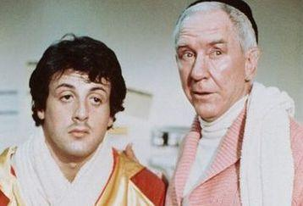
Relationship between weather & climate
Literature Review: Stallone et al. (1976)
Weather
Climate

Slide 44

Climate and Extreme Weather
Kinda impulsive
Short attention span
Very sensitive to his environment
Prone to occasional extreme behavior, given the “right set of ingredients”
Forgets quickly, “moves on”
Let’s call this kid weather

Slide 45

Climate and Extreme Weather

Slide 46



Climate and Extreme Weather
Still impulsive
Still responds mostly to his immediate environment
Still spends months at a time hanging out with influential friends “La Nina” and “El Nino”
But seems to be getting into weird situations more often
The drivers of his individual days are mostly similar
The trajectory of his life has changed

Slide 47
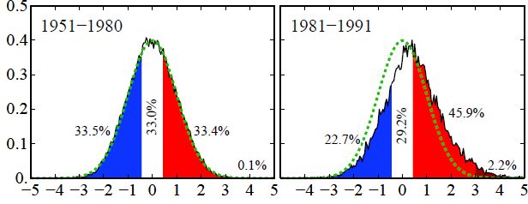
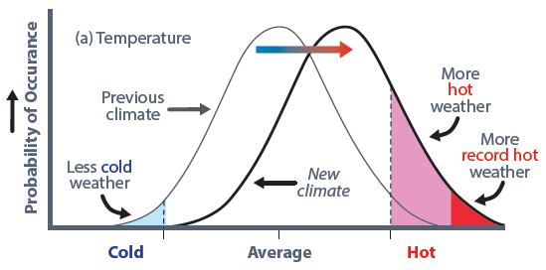
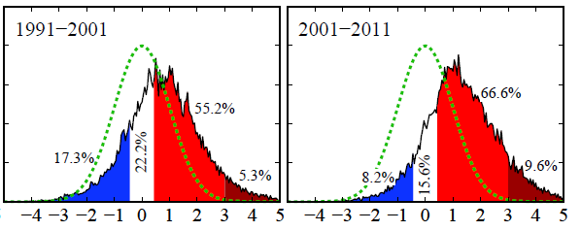
Big Heat Increasing / Big Cold Decreasing
Theoretical shift toward more hot extremes and fewer cold extremes in a warming world
Observed Shift: Summer temperatures in N. Hemisphere land areas
From Hansen et al., Proceedings of the National Academy of Sciences, 2012.

Slide 48
What Extremes are Increasing?
Abundantly clear signal -
  Big Heat is UP; Big Cold is DOWN
  Big Rain is UP
Less clear signal
  Big Drought is UP (but regionally)
  Hurricanes:
    Not much consensus on Frequency increase;
    Some (but not unanimous) consensus that intensity is UP
  Apparent rise in tornadoes is an artifact in data, not the climate.
Even less clear signal
  Snow, Ice: Expect regional trends, no clear signal so far
  Local Winds, Hail: ???

Slide 49
Some Tools and Resources
Recognizing that the climate monitoring work we do would not be possible without the many dedicated professionals at NCEI, across NOAA, across the country and across the ages

Slide 50
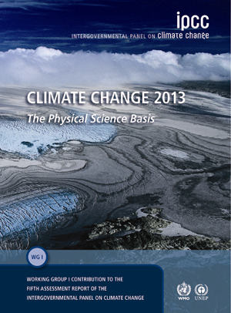

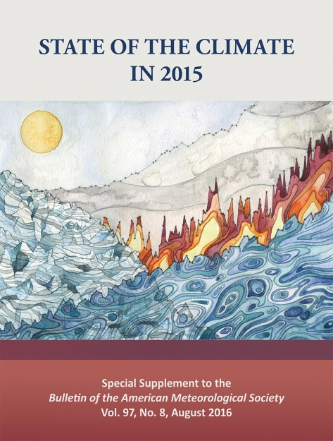



Climate Assessment Reports

Slide 51


State of the Climate: http://www.ncdc.noaa.gov/bams

Slide 52


Climate Assessment Reports:
Recent Additions
Climate Science Special Report
https://science2017.globalchange.gov/
Nat’l Climate Assessment v4 Public Draft
http://www.globalchange.gov/nca4

Slide 53

Climate Assessment Reports:
Recent Additions
Status of the Global Climate: 2017
https://public.wmo.int/en/media/press-release/2017-set-be-top-three-hottest-years-record-breaking-extreme-weather

Slide 54


Indicators of Global Change http://www.globalchange.gov/browse/indicators

Slide 55

NOAA Data in the Classroom https://dataintheclassroom.noaa.gov/

Slide 56

Monthly / Seasonal Public Reports http://www.ncdc.noaa.gov/sotc/
Click for schedule of upcoming releases
Monitoring lenses:
  What happened?
  How different than average?
  How unusual is this difference?
  Is it part of trend or expected trend?
  What were impacts?
U.S. reports released ~ 6th/8th
  1st date: data and brief overview
  2nd date: full-length reports
  Some reports (like “snow and ice”) go dormant in the off-season
Global reports released ~ 18th
  Associated data released same day

Slide 57

Climate at a Glance https://www.ncdc.noaa.gov/cag
Menu-driven system to analyze regional trends
T_{avg}, T_{min}, T_{max}, Precipitation, degree days, drought indices
Best climate data we have at this scale: homogenous, rural-dominated, corrected for artifacts
Web services underneath the interface can be leveraged by outside apps.

Slide 58


Climate at a Glance: Louisiana https://www.ncdc.noaa.gov/cag, or https://www.ncdc.noaa.gov/cag/time-series/us/16/0/tmax/3/8/1895-2017

Slide 59

Climate at a Glance: Louisiana https://www.ncdc.noaa.gov/cag, or https://www.ncdc.noaa.gov/cag/time-series/us/16/0/tmin/3/8/1895-2017

Slide 60

Climate at a Glance https://www.ncdc.noaa.gov/cag

Slide 61

Climatological Rankings https://www.ncdc.noaa.gov/temp-and-precip/climatological-rankings/

Slide 62


U.S. Drought Monitor https://www.drought.gov/ & http://droughtmonitor.unl.edu

Slide 63


Snow products for FEMA (& NWS) http://www.ncdc.noaa.gov/snow-and-ice/
Daily U.S. Snowfall and Snow Depth:
This season’s observed snow, as NCEI gets the info

Slide 64


Billion Dollar Wx and Cx Disasters https://www.ncdc.noaa.gov/billions/
Subdivide by hazard and by state (not shown) →

Slide 65
A Story
that has little to do with climate change,
little to do with today,
little to do with Asheville,
and also, everything to do with all three

Slide 66



I’m from Oklahoma …
… you may know part of our climate history

Slide 67


Slide 68

The Drought Decade
Palmer Hydrologic Drought Index: OKCD2
The “Dust Bowl”
The 1950s

Slide 69
The complex model of what you’ll need to know while “doing something” about climate change
The Water Cycle
Vulnerability
Other things
that make us specialists

Slide 70

Thank you for your time. Do your best.
Deke Arndt: Derek.Arndt@noaa.gov
National Centers for Environmental Information: Asheville (Climate)
https://www.ncei.noaa.gov
http://www.facebook.com/NOAANCEIclimate
Twitter: @NOAANCEIclimate
Made in Asheville!

Slide 71
References: State of the Climate
BAMS State of the Climate (Annual, comprehensive):
  https://www.ncdc.noaa.gov/bams
  https://www.ametsoc.org/ams/index.cfm/publications/bulletin-of-the-american-meteorological-society-bams/state-of-the-climate/
NOAA/NCEI State of the Climate (monthly, primarily meteorological and drought elements of climate):
  US: https://www.ncdc.noaa.gov/sotc/national
  Global: https://www.ncdc.noaa.gov/sotc/global
National Climate Assessment:
  http://nca2014.globalchange.gov/report
  http://www.globalchange.gov/nca4
  https://science2017.globalchange.gov
Indicators of Global Change:
  http://www.globalchange.gov/browse/indicators

Slide 72
References: Climate & Extreme Weather
National Climate Assessment:
  http://nca2014.globalchange.gov/report
BAMS Explaining Extreme Events (event attribution):
  https://www.ametsoc.org/ams/index.cfm/publications/bulletin-of-the-american-meteorological-society-bams/explaining-extreme-events-from-a-climate-perspective/
Monitoring & Understanding Change …” State of knowledge series (BAMS, 2013 & 14)
  … in extreme storm statistics. Kunkel, et al. 94(4), 499-514.
    http://journals.ametsoc.org/doi/full/10.1175/BAMS-D-11-00262.1
  … in heat waves, cold waves, floods and droughts in the US. Peterson, et al. 94(6), 821-834.
    http://journals.ametsoc.org/doi/full/10.1175/BAMS-D-12-00066.1
  … in extreme winds, waves, and extratropical storms. Vose, et al. 95(3), 377-386.
    http://journals.ametsoc.org/doi/pdf/10.1175/BAMS-D-12-00162.1
  … in CMIP5 Climate Model Analyses. Wuebbles, et. al., 95(4), 571-583.
    http://journals.ametsoc.org/doi/pdf/10.1175/BAMS-D-12-00172.1

Slide 73
References: Social media & webinars
NCEI Climate:
  Facebook: https://www.facebook.com/NOAANCEIclimate
  Twitter (@NOAANCEIclimate): http://www.twitter.com/NOAANCEIclimate
NCEI Ocean & Geophysics
  Facebook: https://www.facebook.com/NOAANCEIoceangeo
  Twitter (@NOAANCEIocngeo) http://www.twitter.com/NOAANCEIocngeo
NCEI/CPC Monthly climate science and services webinars:
  https://www.ncdc.noaa.gov/sotc/briefings

Slide 74
Extra Slides

Slide 76

Year-to-date “horserace” graphic

Slide 77

Some situations call for tracking ingredients
In situations for which the ability to detect a phenomenon has changed over time
Sometimes more useful to track phenomenon’s constituent variables (“ingredients”) to better grasp the impact of climate change
  Examples: tornadoes (shear, instability), tropical cyclones (SSTs, shear, etc.)

Slide 78




Nationally: Big Heat is Increasing
NOAA/NCEI Climate Extremes Index: http://www.ncdc.noaa.gov/extremes/cei
(Big Cold is generally decreasing)

Slide 79

Big Rain is Increasing
On average, with significant regional patterns, heavy precip is increasing in two aspects:
Large events are now responsible for more of the annual rainfall budget
Large events are generally getting larger
This has consequences.
Adapted from National Climate Assessment 2, US Global Change Research Program.

Slide 80
Extreme Precipitation
Ingredients: sufficiently moist air, sufficient lift
An easy one
Rule of thumb (works often, not always) for general precipitation in a changing climate: wet places/seasons/phenomena get wetter; dry places/seasons/phenomena get drier
For the most part, the data are in great shape, and support this

Slide 81

Extremes in Temperature
3 to 4
4.8 to 1
https://www.ncdc.noaa.gov/cdo-web/datatools/records

Slide 82

It’s not just temperature
These years were pretty droughty for the CONUS
These years were also “wetter than average” for the CONUS

Slide 83


Extreme Events
How we detect, count and measure extreme events has changed, for each event type, since mid-20th century.

Slide 84

Hurricanes & Tropical Cyclones
Ingredients:
Warm water
Supportive shear profile
Observed / Projected Trends:
Still working on understanding effects on trends of TC frequency
Some confidence that TCs will become more intense (on average) in certain basins
Known: Sea level rising; makes the impact of a given TC potentially more destructive

Slide 85

Violent Local Weather
Long-term trends tough to ID because we have become so much better at predicting/verifying
Climate-scale ingredients & Trends:
Instability is likely increasing / will increase
Shear, in the long term, decrease
Some “long term trends vs. game day” issues
July 23, 2010: Vivian, SD

Slide 86


Measures of Drought
Palmer Drought Severity Index – and many cousins
Standardized Precipitation Index – and cousin
Keetch–Byram Drought Index

Slide 87


Other Drought Monitoring Criteria
Monthly SPI
  Can be useful for determining Dx intensity once drought is established, but not for triggering drought
Monthly Percent of Normal Precipitation
  Not as useful if normal is too much different from the monthly minimum precip drought trigger
Notes:
Climatology and seasonality of precipitation at a station can determine usefulness of SPI and PNP.
SPI: For wet stations and wet season, SPI can be negative yet actual precip can still be > 8” or 4” minimum. For dry season, SPI can be positive yet actual precip can be well below the monthly minimum.
Percent of Normal Precip: Same dilemma as SPI. PNP can be below normal during wet season while actual precip is above the monthly minimum. PNP can be above normal during dry season while actual precip is well below the monthly minimum.

