Slide 1
The End of Lecture
The Future of Evidence-Based Teaching
Mary Pat Wenderoth
NABT 11.10.17
Notes:
----- Meeting Notes (6/2/15 05:52) -----

Slide 2
Discussion Question:
Why do faculty lecture?

Slide 3
We strongly believe that lecture leads to deeper understanding.... (Rosenthal 1995)
I just know that students .... (UW professor, 3/09)
… we feel that our junior-senior cell biology course ... works extraordinarily well …” (Lodish et al. 2005)
We think that our objective of teaching the students to think was well-accomplished. (Miller & Cheetham 1990)

Slide 4
We strongly believe that lecture leads to deeper understanding.... (Rosenthal 1995)
I just know that students .... (UW professor, 3/09)
… we feel that our junior-senior cell biology course ... works extraordinarily well …” (Lodish et al. 2005)
We think that our objective of teaching the students to think was well-accomplished. (Miller & Cheetham 1990)

Slide 5
Discussion Question:
What is Evidence-Based Teaching? (aka active learning)

Slide 6
What is
Evidence-Based Medicine?

Slide 7
Discussion Question:
What does Evidence-Based Teaching look like? (aka active learning)

Slide 8
Evidence-based teaching
Students
1. practice what is to be learned
2. practice higher order thinking (analysis, synthesis, evaluation)
3. are held accountable
4. have immediate feedback from faculty/peers
5. see mistakes as opportunities to learn
Less information transmission Greater focus on cognitive skills

Slide 9
Evidence-based Teaching
(aka active learning)
“Ask, Don’t Tell”

Slide 10
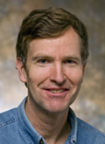
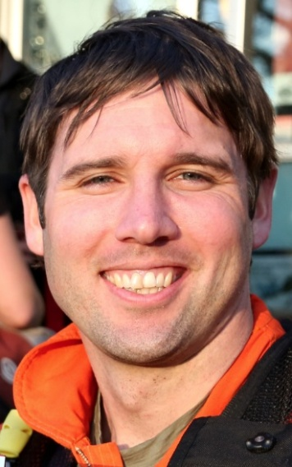
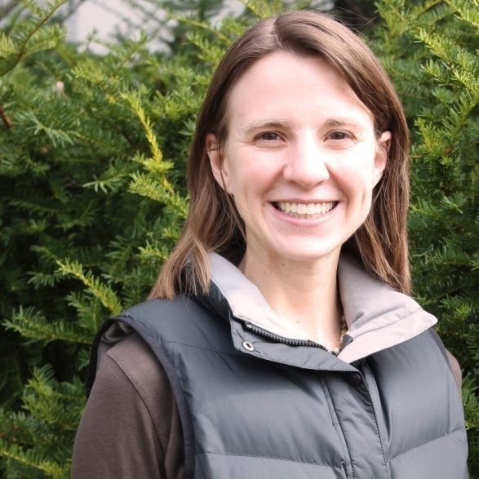
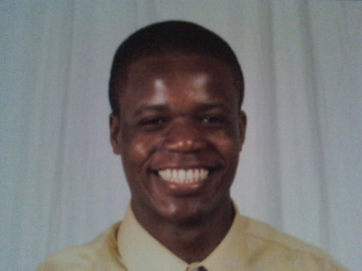
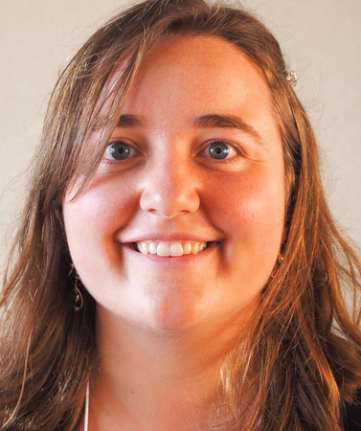
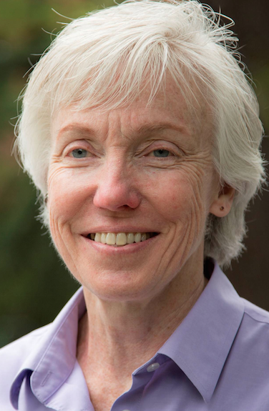
Does active learning really work?
Is there DATA ?
Started project: 2 January 2008
“Ended” project: 12 May 2014
Scott Freeman, Sarah L. Eddy, Miles McDonough, Michelle K. Smith, Nnadozie Okoroafor, Hannah Jordt, & Mary Pat Wenderoth. 2014 PNAS 1111(23): 8410-8415 www.pnas.org/cgi/doi/10.1073/pnas.1319030111

Slide 11
A meta-analysis:
Five criteria for admission
active learning vs traditional lecturing
2. regularly scheduled course
3. occurs during class sessions
4. undergraduate STEM courses
data on academic performance
DFW or Exam scores

Slide 12
Literature Searching
Hand-search every issue 55 STEM education journals 1998 to 2010; (titles/abstracts)
2. Query seven online databases using 16 terms;
3. Mine 42 bibliographies and qualitative or quantitative reviews;
4. “Snowballing”

Slide 13
A meta-analysis:
Five criteria for admission

Slide 14
A meta-analysis:
Five criteria for admission
active learning vs traditional lecturing
2. regularly scheduled course
3. occurs during class sessions
4. undergraduate STEM courses
data on academic performance
DFW or Exam scores

Slide 15
Coding:
642 papers (one researcher reads)
Do they meet 5 criteria?
no
yes
244 “easy rejects”
398 two coders (SF + MPW, MKS, MM, DO, HJ)
confirm 5 criteria
no
assessments identical?
academic ability of students noted?
DATA- meta-analyzable? (DFW: exam scores)
reject
Missing data search (91 papers, 19 successful)
Data analysis: 225 studies

Slide 16
398 two coders (SF + MPW, MKS, MM, DO, HJ)
confirm 5 criteria
assessments identical?
academic ability of students noted?
DATA- meta-analyzable? (DFW: exam scores)
reject
Data analysis: 225 studies

Slide 17
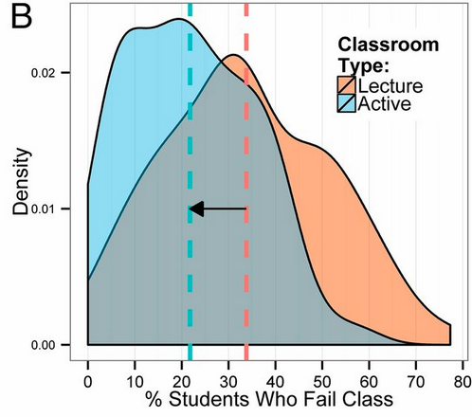
Active
22%
34%
Lecture
Results:
Failure Rate DFW
(67 studies)
Risk ratio = 1.5; students in lecture1.5x more likely to fail

Slide 18
Results: Failure Rate
(67 studies)
If this was a biomedical randomized control trial, it would be STOPPED
3,516 fewer students would fail;
~$3.5M in saved tuition.

Slide 19
Failure Rate by Discipline
Traditional lecture
95% confidence interval
Biology
Chemistry
CS
Engineering
Geology
Math
Physics
Overall
7
7
7
14
14
7
7
STEM Discipline
12
Number of independent studies
12
2
2
15
10
% Decrease in Fail Rate

Slide 20
Conclusion?
Traditional lecture
Biology
Chemistry
CS
Engineering
Geology
Math
Physics
Overall
7
7
There is a significant
decrease in failure rate in
STEM discipline > 7 studies
biology but not other STEM disciplines
14
7
12
2
2
15
10
10
20
% Decrease in Fail Rate

Slide 21
Conclusion?
Traditional lecture
Biology
Chemistry
CS
Engineering
Geology
Math
Physics
Overall
7
7
There is a significant
decrease in failure rate in
STEM discipline > 7 studies
biology but not other STEM disciplines
14
7
12
2
2
15
10
10
20
% Decrease in Fail Rate

Slide 22
EXAMS
33
95% confidence interval
22
8
Number of independent studies
19
2
2
29
31
Used to determine small, med, large effect size
In K-12, 0.2 is large effect size
14
Notes:
Statistical significance does imply meaningfulness
Effect size: standardized group mean differences
Cohen’s d= Mean1-Mean 2
SD pooled

Slide 23
Exams
Mean 1 – Mean 2
SD pooled
Effect Size =

Slide 24
Exams
95% confidence interval
33
In which disciplines
does Active Learning improve exam performance?
22
8
19
All disciplines
Only CS & Geology
All but CS & Geology
2
2
29
31
14

Slide 25
Exams
95% confidence interval
33
In which disciplines
does Active Learning improve exam performance?
22
8
19
All disciplines
Only CS & Geology
All but CS & Geology
2
2
29
31
14

Slide 26
Results
Exams
Overall effect size = 0.47 With active learning, exam scores increase by almost half a SD
(exam difficulty the same)
In intro STEM classes @ University of Washington
6% increase in exam scores; 0.3 increase in average grade (4.0 scale)

Slide 27
Exam Data by Class Size
<50
47
Class Size
50-110
50-110
28
>110
30
Active learning works
only in small classes
only in large classes
across a variety of class sizes

Slide 28
Exam Data by Class Size
<50
47
Class Size
50-110
50-110
28
>110
30
Active learning works
only in small classes
only in large classes
across a variety of class sizes

Slide 29
Which class do you want to take?
1
2
Active Learning course lower fail rate higher grades
Traditional lecture course
higher fail rate lower grades

Slide 30
June 2014
As of November 9, 2017
Downloads abstract 217,501
PDF 112,478
Altmetric Score
1793
99% of all PNAS articles of similar age
99% of all tracked Journal articles of similar age

Slide 31
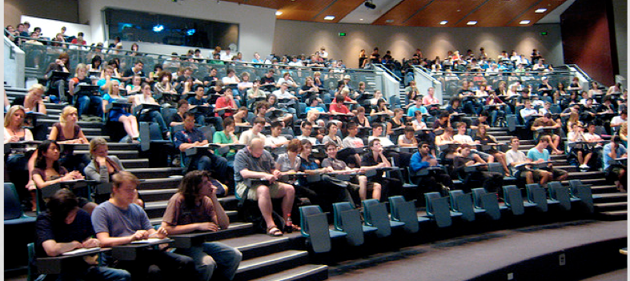
What traditional lecturing looks like

Slide 32
1350
Notes:
1350 classroom
Henry of Germany delivers a lecture in 14th Century Bologna
Laurentius de Voltolina: Liber ethicorum des Henricus de Alemannia:
Middle ages/ Dark Ages 500-1500 AD

Slide 33
What would you do?
A job candidate presents his/her job talk.
While listening to the talk you realize
they have ignored the research literature of the past 30 years
their methods are > 700 years old
the methods are known to be less effective
Would you hire them?

Slide 34
Meta-analysis shows that
active learning
improves student learning
Does this make lecturing academic malpractice?

Slide 35
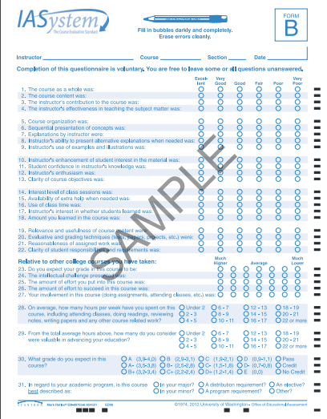
How to assess teaching methods?
Student Evaluation of Teaching (SETs)

Slide 36
Student Evaluation of Teaching (SETs)
Meta-analysis of faculty's teaching effectiveness: Student evaluation of teaching ratings and student learning are not related. Uttl, B, C. A. White, D. W. Gonzalez Studies in Educational Evaluation (2016)
“no significant correlations between SET ratings and learning”

Slide 37
How to evaluate teaching methods?
Ask faculty

Slide 38
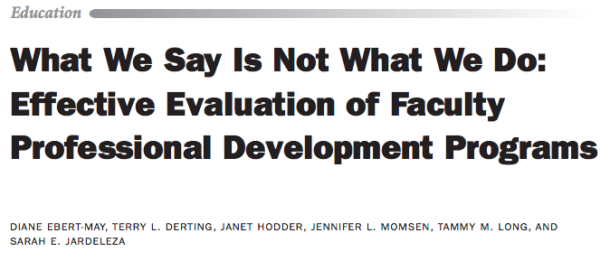
Ebert-May, D.et al. (2011). BioScience, 61(7), 550-558.

Slide 39
How to evaluate teaching methods?
Create a classroom observation rubric based on the 1° literature

Slide 40
Dr. Sarah Eddy- Literature search
Single interventions that improve learning
Found 21 different interventions (elements)
CBE-Life Science Education 2015

Slide 41
PORTAAL - Four Dimensions
Practice
Logic
Accountability
Reducing Apprehension

Slide 42
PORTAAL
Each dimension has elements
Practice
P 1. Frequent practice
P 2. Align practice and exams
P 3. Distributed practice
P 4. Immediate feedback
Each element - citations

Slide 43
METHODS
Trained coders to use PORTAAL
Scored 3 classes each instructor
Scored 27 different Intro Biol instructors

Slide 44
Practice
# Instructors
0
50
P1. Avg. minutes of class students talking
RED- Faculty that dropped fail from 20% to 6%
BLUE- faculty that dropped fail from 22% to 10%

Slide 45
Practice
P1. Minutes of class students talking
# Instructors
0
50
RED- Faculty that dropped fail from 20% to 6%
BLUE- faculty that dropped fail from 22% to 10%

Slide 46
Logic
% activities higher cognitive order

Slide 47
Logic
% activities explain answer to peer

Slide 48
Accountability
% activities random call

Slide 49
In Intro biology courses at UW, females are 60% of class.
What % of students who volunteer to answer questions are female?
1. ~ 60%
2. > 60%
3. < 60%

Slide 50
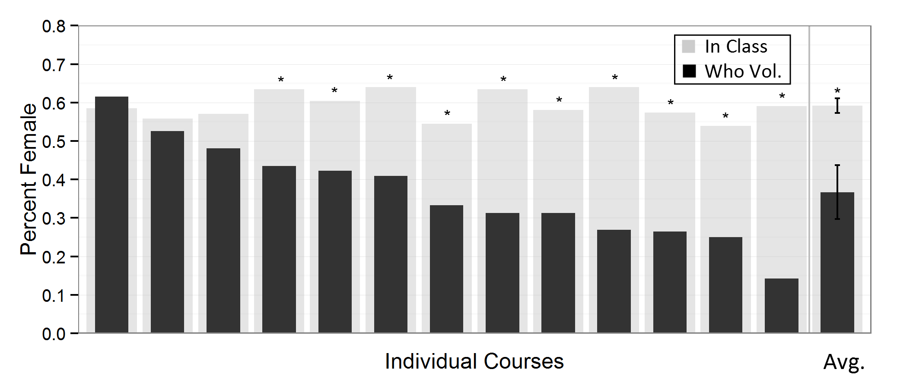
Calling on volunteers
% FEMALES in class
% FEMALE who answer
Eddy, S.L.*, S.E. Brownell*, M.P.Wenderoth. 2014 Gender gaps in achievement and participation in multiple introductory biology classrooms. CBE- LSE 13:478-492

Slide 51
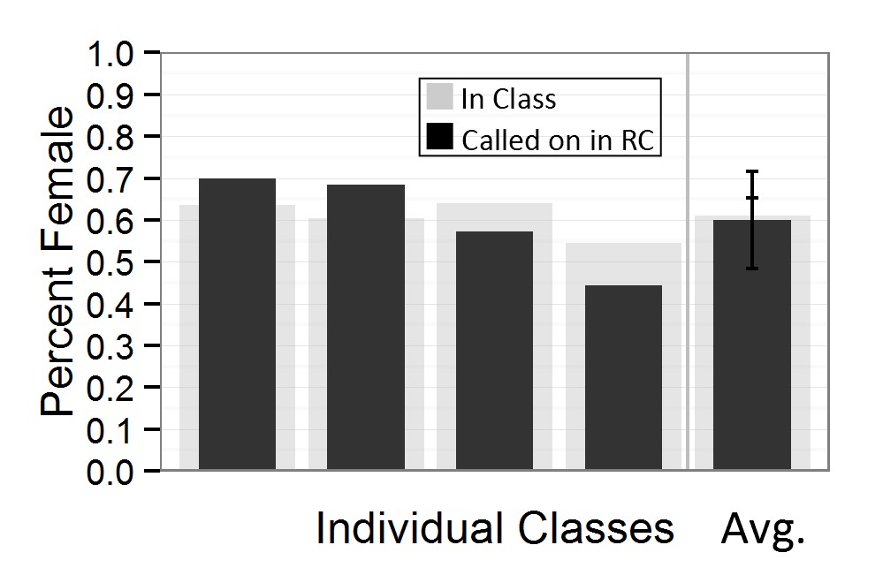
Using Random Call
% FEMALE
Eddy, S.L.*, S.E. Brownell*, M.P.Wenderoth. 2014 Gender gaps in achievement and participation in multiple introductory biology classrooms. CBE- LSE 13:478-492

Slide 52
Feb 10, 2016

Slide 53
Evidence-based teaching
“Ask, Don’t Tell”
The person doing the talking
is doing the learning.

Slide 54
Thanks to
Education researchers for producing the evidence that will make our faculty better teachers and our students better learners.

Slide 55
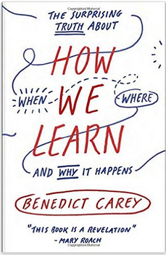
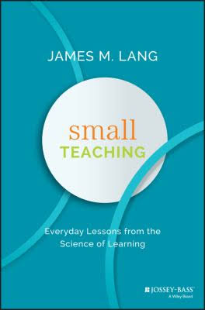
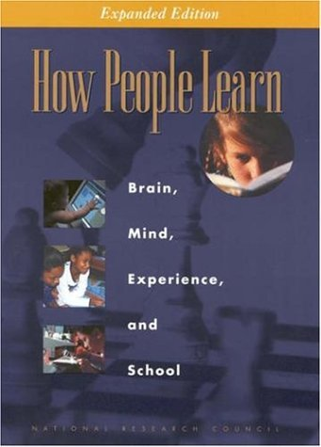
How We Learn
Small Teaching
How People Learn
Self-Theories
Choke
Switch

Slide 56
Questions

Slide 57
References
Freeman, S., Eddy, S. L., McDonough, M., Smith, M. K., Okoroafor, N., Jordt, H., & Wenderoth, M. P. (2014). Active learning increases student performance in science, engineering, and mathematics. Proceedings of the National Academy of Sciences, 201319030.
Freeman, S., D. Haak, and M.P. Wenderoth. 2011. Increased Course Structure Reduces Fail Rates in Introductory Biology. CBE Life Science Education 10 (2):175-186
Freeman,S., E. O’Connor, J. W. Parks, M. Cunningham, D. Hurley, D. Haak, C. Dirks, M.P. Wenderoth. 2007. Prescribed Active Learning Increases Performance in Introductory Biology. CBE Life Sciences Education 6(2): 132–139
Crowe*, A, C. Dirks*, and M.P. Wenderoth*. 2008. Biology in Bloom: Implementing Bloom’s Taxonomy to Enhance Student Learning in Biology. CBE-Life Sciences Education 7 (4): 368-381*Authors contributed equally
Eddy, S. L., & Hogan, K. A. (2014). Getting Under the Hood: How and for Whom Does Increasing Course Structure Work?. CBE-Life Sciences Education,13(3), 453-468.
NY Times article on closing achievement gap in Intro Biology.
http://www.nytimes.com/2014/09/03/education/active-learning-study.html?_r=0
Dallimore EJ, Hertenstein JH, Platt MB(2013). Impact of cold-calling on student voluntary participation. J Manage Educ 37, 305-341.

Slide 58
https://sites.google.com/site/uwbioedresgroup

